Slide 1
UNIT-1 Need, basic Guidelines, Content & Process for V.E.
Basic Human Aspiration and it Fulfilment
Holistic Development and
The Role of Education

Slide 2
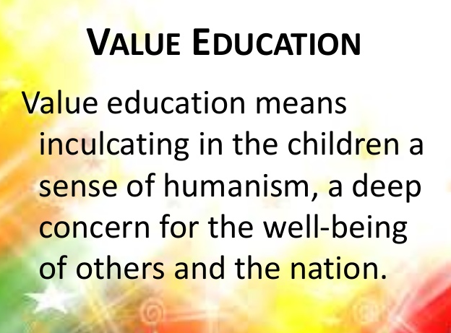
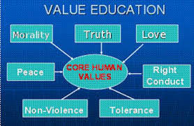
INTRODUCTION OF VALUE EDUCATION

Slide 3
Need for Value Education
All human beings aspire for a happy, fulfilling life. For a human being, there are two important questions pertaining to this:
• What is my aspiration? (What to do?)
• How to fulfil my aspiration? (How to do?)
The purpose of education is to facilitate the development of clarity on the aspiration and adequate competence to actualize it
it is essential to understand-
what a happy, fulfilling and successful life is ?
what is really valuable for human being?
what is our purpose as a human being?
Understanding human aspiration, or what is really valuable for human being, is the value domain?
The subject which enables us to understand this domain is called ‘Value Education’ (VE).
The present education system has largely become skill-biased. For developing skills, the prime emphasis is on science and technology, without a base of values. Skills can only help to provide the means to achieve what is considered valuable.

Slide 4
Conti…
The following aspects to appreciate the need for value education.
Correct identification of our aspirations;
Understanding UHV to fulfil our aspirations in continuity;
Complementarity of values and skills;
Evaluation of our beliefs;
Technology and human values.

Slide 5
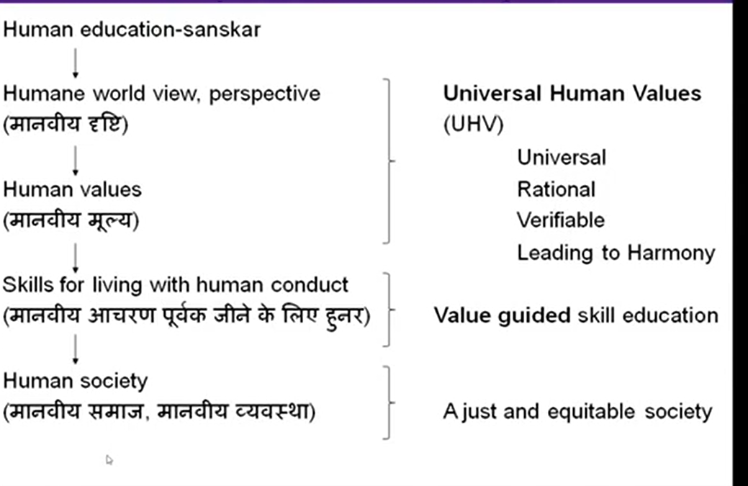
BASIC GUIDELINES FOR VALUE EDUCATIONS B

Slide 6
Guidelines for Value Education
For any input to qualify for Value Education, the following guidelines for the content of the course are important:
Universal: It has to be universally applicable to all human beings for all time and all places. This implies that values should not change according to sect, creed, nationality, gender, etc.
Rational: It has to appeal to reasoning; and not be based on dogmas or blind beliefs. It has to be open to address the related questions. It cannot be a set of sermons or do’s and don’ts.
Natural and Verifiable: It has to be 'naturally acceptable' to the human being and there needs to be every provision in nature for its fulfillment. It needs to be experientially verifiable, and not based on dogmas, beliefs or assumptions. It is not merely an intellectual exercise or information transfer.
All Encompassing: It needs to cover all dimensions (thought, behaviour, work and understanding) and levels (individual, family, society and nature/existence) of human life.
Leading to Harmony: It ultimately needs to promote harmony within the individual, among human beings and with the entire nature.

Slide 7
Content of this Session इस सत्र कि विषय-वास्तु
Basic human aspiration
Fulfilment of basic human aspiration
It will also give an idea about:
  The content of this workshop/course
  The process of this workshop/course
  The expected achievement from right understanding
मानव की मूल चाहना
मानव की मूल चाहना की पूर्ति
इस सत्र से इन तीन के बारे एक अनुमान बन पायेगा:
  शिविर/कोर्स कि विषय-वास्तु
  शिविर/कोर्स कि प्रक्रिया
  समझ से अपेक्षित उपलब्धि

Slide 8
Content of Value Education
The value of an entity is its participation in the larger order of which it is a part. The context is always the larger order. Value has to do with the participation of a unit in the larger order. E.g. a piece of chalk is a unit. The classroom is the larger order for this unit. The value of chalk is that it can be used to write on the blackboard for the desired functioning of the classroom.
That means the content or scope of study has to be all encompassing, i.e.
• It has to cover all dimensions of human being – thought, behavior, work and realization.
• It has to cover all levels of human living – individual, family, society, nature and existence.
Continuous Happiness and Prosperity as Basic Human Aspirations Whatever we think, whatever we do is with some end state in mind. That end state is our basic aspiration.
When you ask yourself:
  • Do I want to be happy?
  • Do I want to be prosperous?
  • Do I want the continuity of happiness and prosperity?
The answers are in affirmative yes. We have a natural acceptance for continuity of happiness and prosperity. These are our basic aspirations.

Slide 9
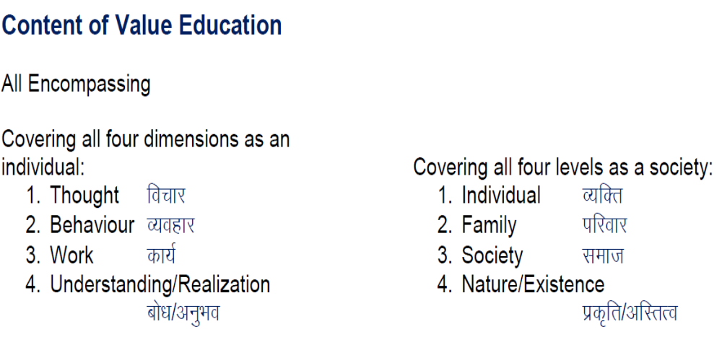

Slide 10
Basic Requirements for Fulfilment of Human Aspirations
When we try to find out if we have fulfilled our basic aspiration, it is not always so affirmative. There is quite a gap between our basic aspiration and our state of being.
This is something we need to explore in our own life. Where are we putting in our effort?
If continuity of happiness and prosperity is not achieved by just accumulating physical facility then what else is essential to do?
Let’s try to find out by asking this question to ourselves: Is the unhappiness in my family
  ▪ More due to lack of physical facility or
  ▪ More due to lack of fulfilment in relationship?
When you explore into it, you will find that the major reason for the unhappiness in the family is the lack of fulfilment in relationship and not just the lack of physical facility. Now to look at the investment of your effort, find out:
  ▪ How much time and effort you are investing for physical facility, and
  ▪ How much time and effort you are investing for fulfilment in relationship?

Slide 11
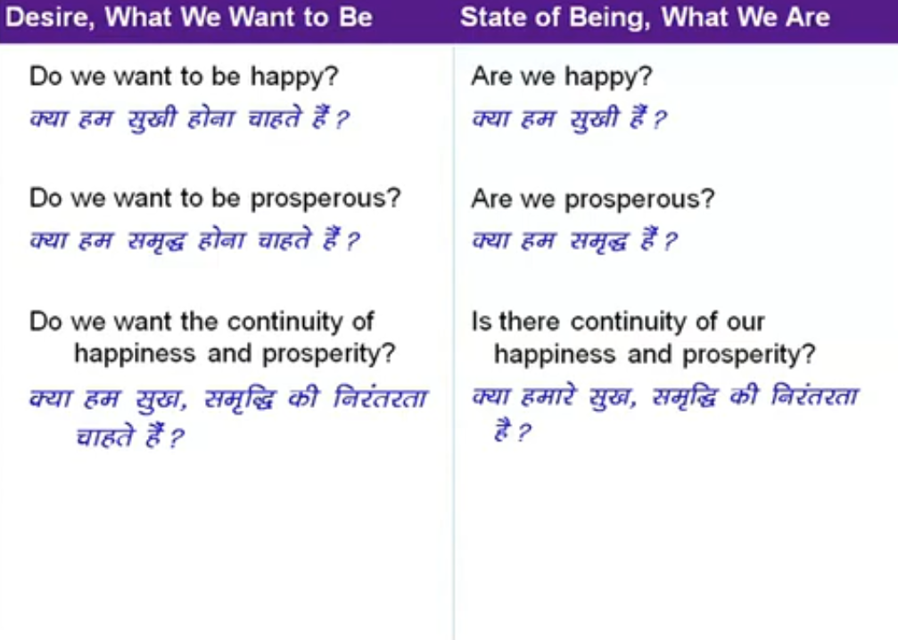
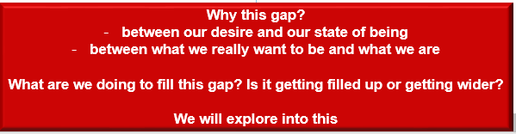

Slide 12
Conti…
For human being physical facility is necessary, but relationship is also necessary.
In fact, by seeing this, we can understand the difference between animals and human beings. Physical facility is necessary for animals as well as for human beings. For animals, it is necessary as well as adequate. But when it comes to human beings, that is not the case – physical facility is a necessity, but physical facility alone is not going to suffice for the fulfilment of human being.
When a human being has lack of physical facility, (s)he becomes uncomfortable and unhappy. Once (s)he gets the physical facility, (s)he forgets about it and starts thinking about many other things.
So, we can conclude that physical facility is necessary for animals; it is necessary for human beings also. However:
• For animals, physical facility is necessary as well as adequate.
• For human beings, physical facility is necessary, but physical facility alone is not adequate

Slide 13
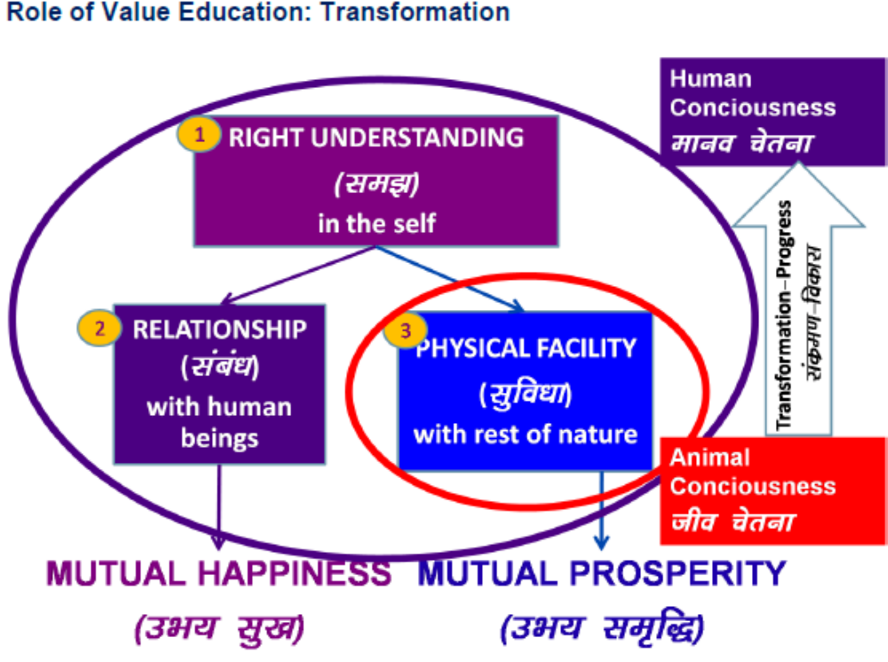
Right Understanding, Relationship and Physical Facility

Slide 14
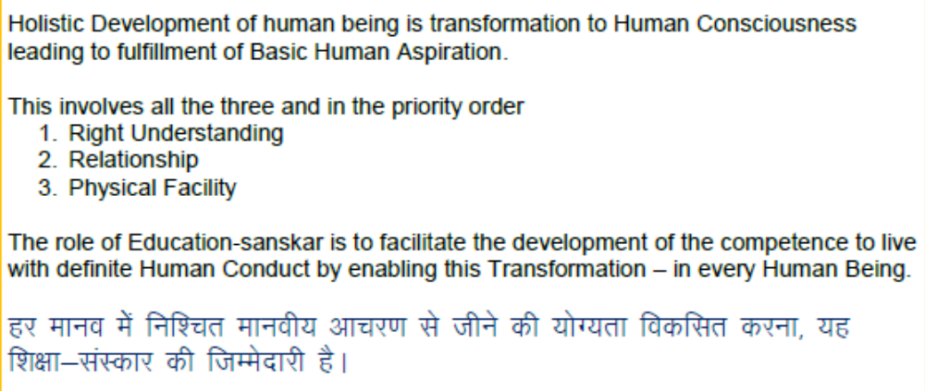

Slide 15
For fulfilment of human being– physical facility, relationship and right understanding – all three are necessary.
A little introspection will show that out of these three, what is naturally acceptable is the first one. You certainly do not want to live in opposition with others. But you may be conditioned to think in a manner as mentioned in the third option. If we adopt the third option, it has significant negative implications in our life, in the family and in the society. We can see this all around today. In relationship, what is generally happening today is something like this:
Every time when there is fight, we want to resolve it. We start the next day with the thought that we don’t want to fight today; but a fight takes place again (sometimes by the end of the same day).
Does this happen with you, with your brother, sister, father, mother, spouse, children, with your friends, co-workers, etc.?
Getting irritated, angry, not speaking for days, dragging each other to court, divorces, etc. are indicators of the situation in relationship. For ensuring fulfilment in relationship, it is necessary to have right understanding about relationship.

